Slide 1
Data Science Tasks
Presentation
By: Srusti M
Domain: Data Science

Slide 2
TABLE OF CONTENTS
01. Acknowledgement
02. Beginner Level
03. Intermediate Level
04. Advanced Level
05. Conclusion

Slide 3
Acknowledgement:
I would like to sincerely thank ShadowFox, my mentor Mr. Hariharan, and coordinator Mr. Aakash for their constant guidance, encouragement, and constructive feedback throughout this journey. Their support has been invaluable in helping me improve my technical as well as professional skills. I am also deeply grateful to My Teachers for providing me with the platform and resources to pursue this internship.
This experience has not only enhanced my knowledge and confidence but also contributed immensely to my overall personal and career growth. I truly cherish the learnings and exposure I have gained through this opportunity.
This internship has broadened my perspective on real-world applications of my academic knowledge. It has also motivated me to continuously upskill and stay curious in the field. I look forward to applying these learnings in future projects and professional endeavors.

Slide 4
Beginner Level
Visualization Library Documentation: I prepared a detailed documentation guide covering two Python visualization libraries. The guide focused on the types of graphs supported (line, bar, scatter, histogram, etc.), along with use cases and code snippets.
Library Overview: Each library’s background, features, and typical use cases were highlighted.
Graph Types & Examples: Multiple visualization types were documented with code demonstrations.
Comparison: A comparative section was included to show strengths and weaknesses of each library in terms of ease of use, customization, interactivity, and handling large datasets.

Slide 5
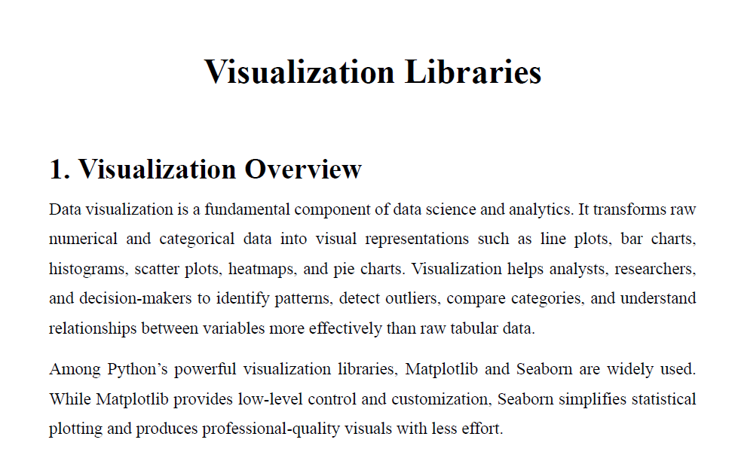
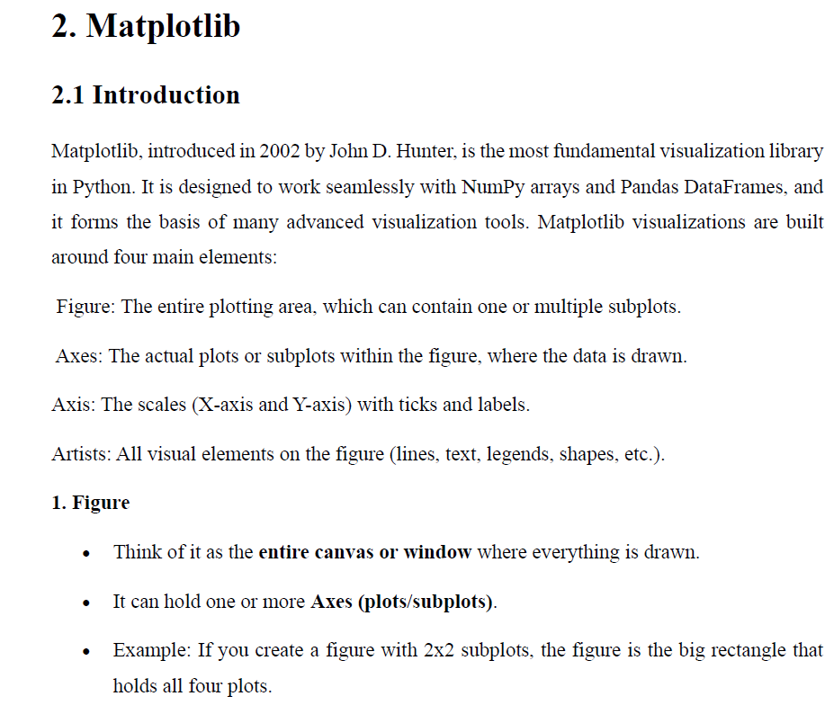
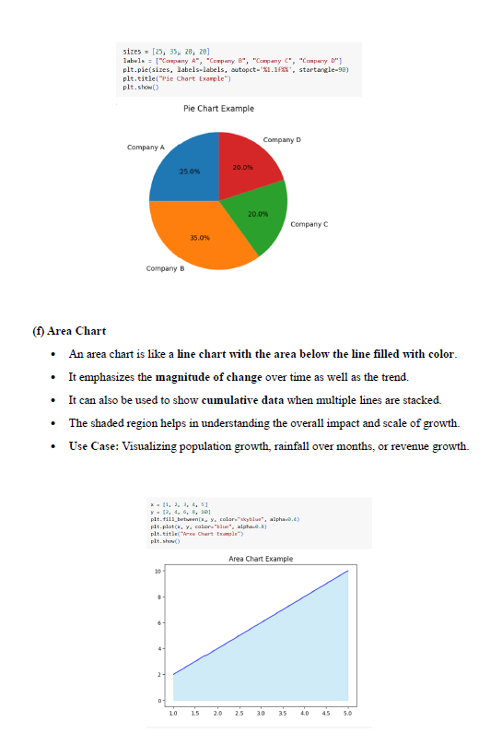
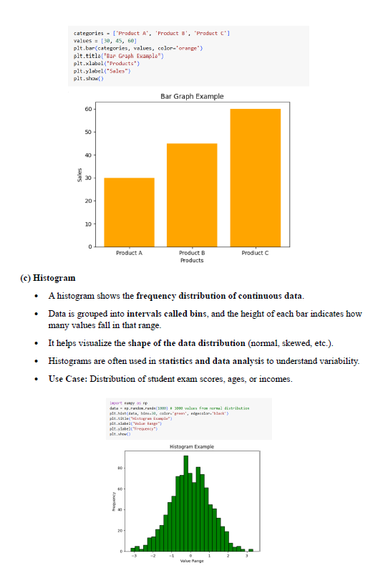
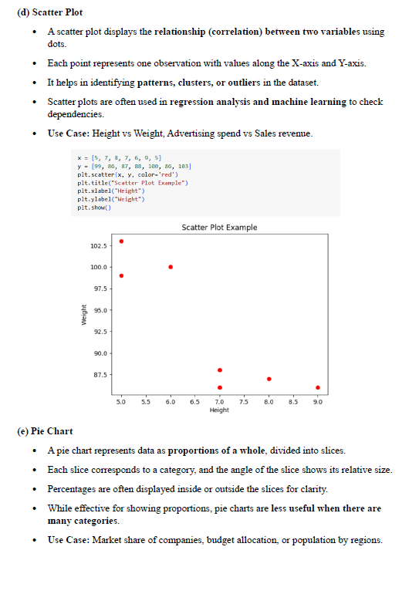
Screenshots 1:

Slide 6
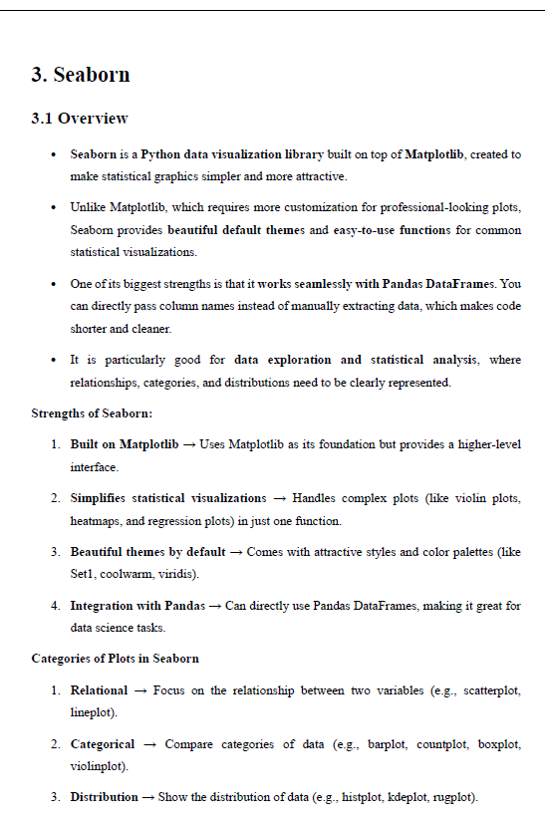
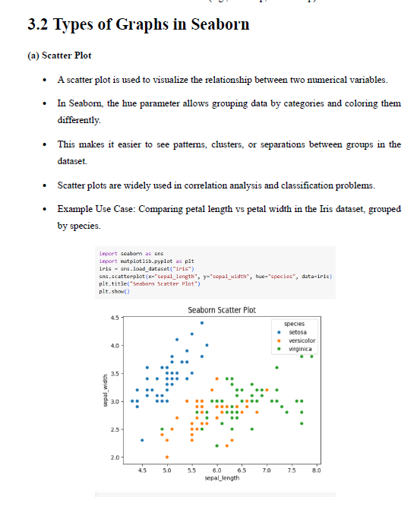
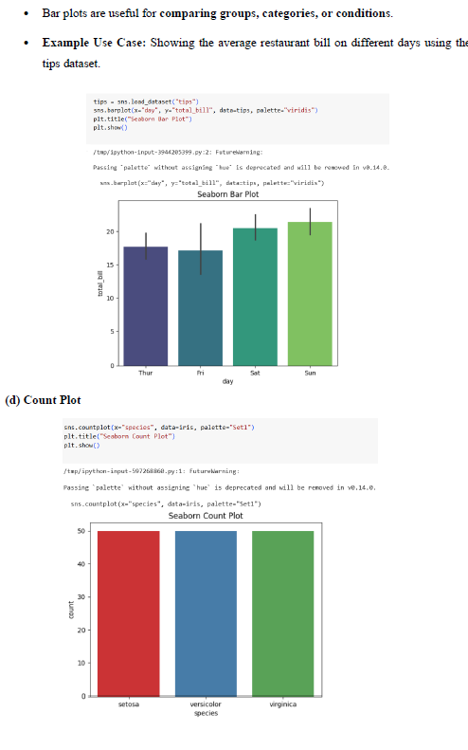
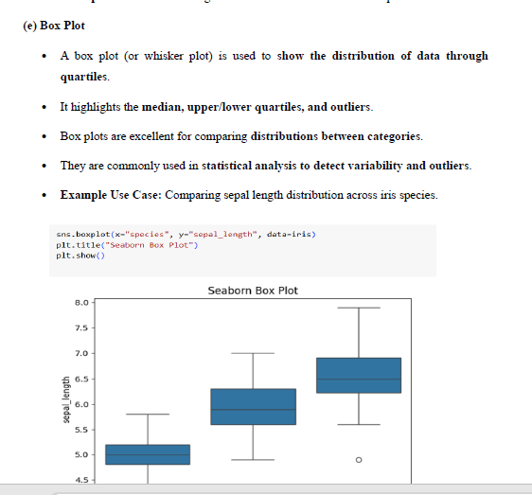
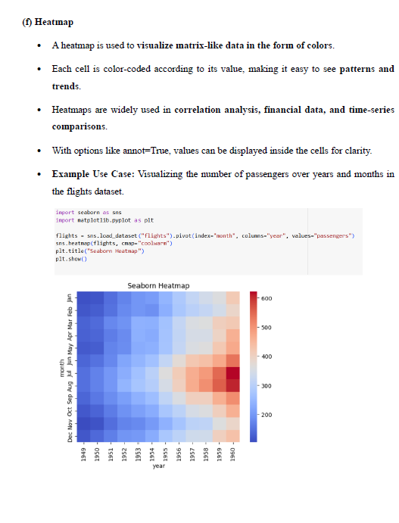
Screenshots 2:

Slide 7
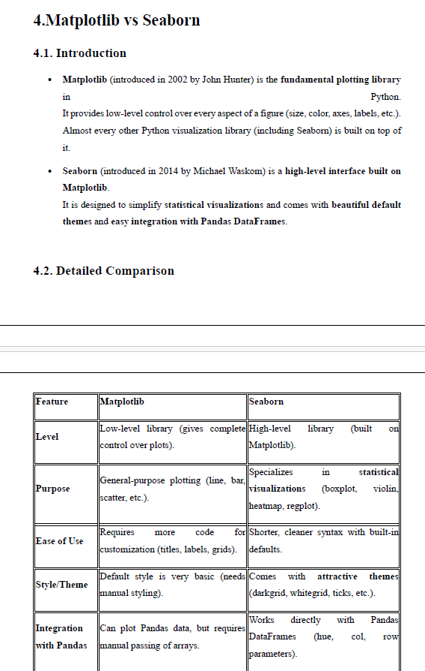
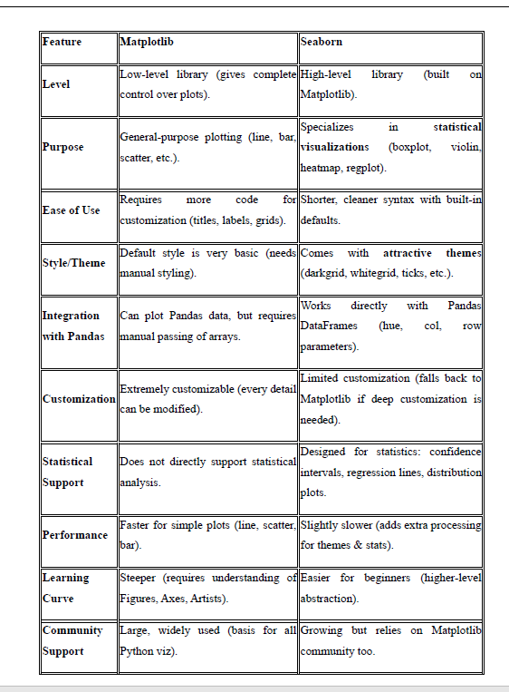
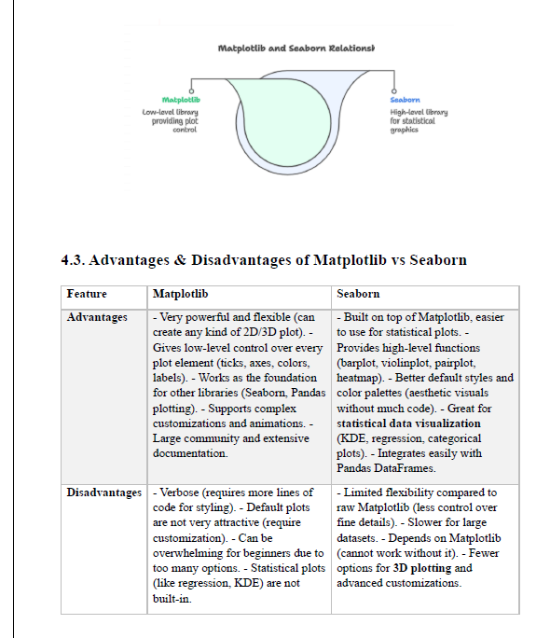
Screenshots 3:

Slide 8
Intermediate Level:
Air Quality Index (AQI) Analysis (Delhi): I conducted a comprehensive study on Delhi’s air quality by analyzing AQI data. Examined pollutants such as PM2.5, PM10, and NO₂.
Identified seasonal variations in AQI values.
Explored the influence of environmental and geographical factors on pollution trends.
Created visualizations (line plots, bar charts, and heatmaps) to present trends clearly.
Applied statistical methods to uncover relationships between pollutants and health risks.

Slide 9
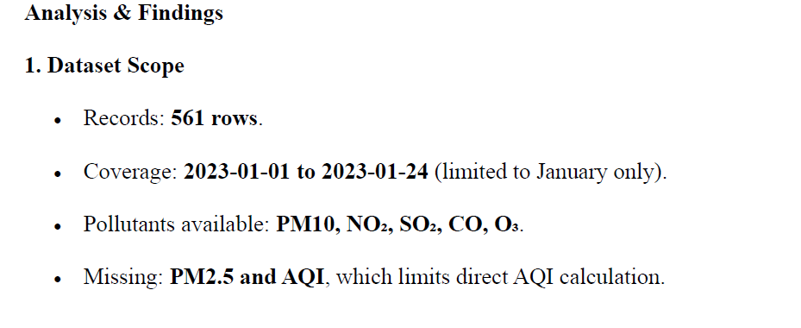
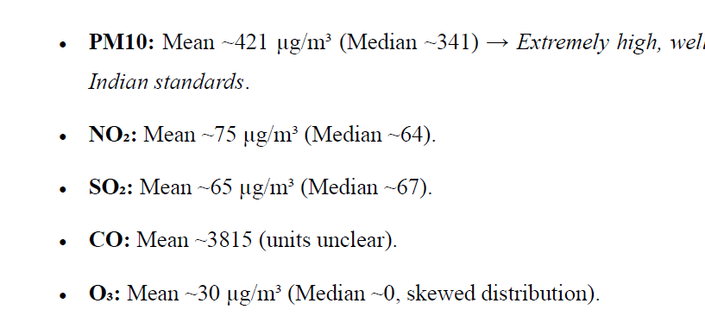
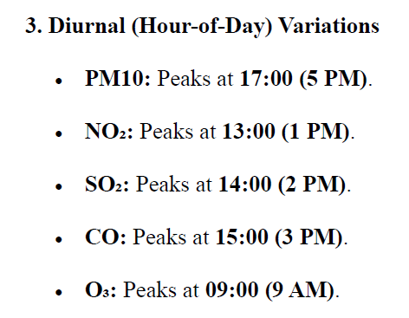
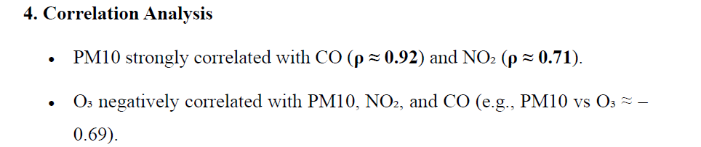
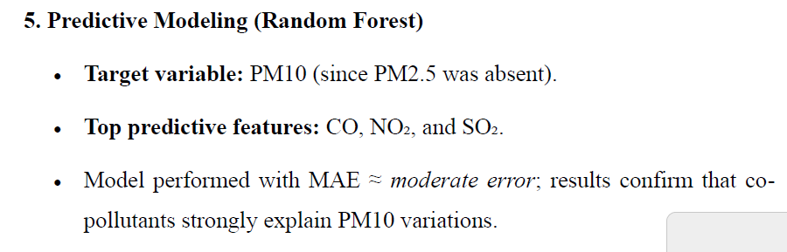
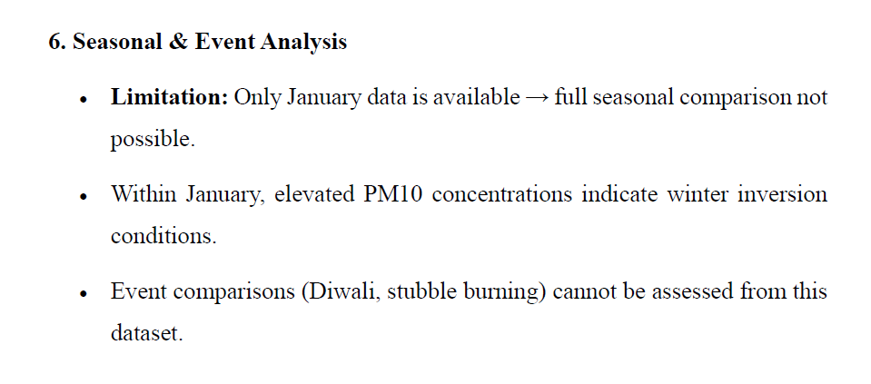
Screenshots 1:

Slide 10
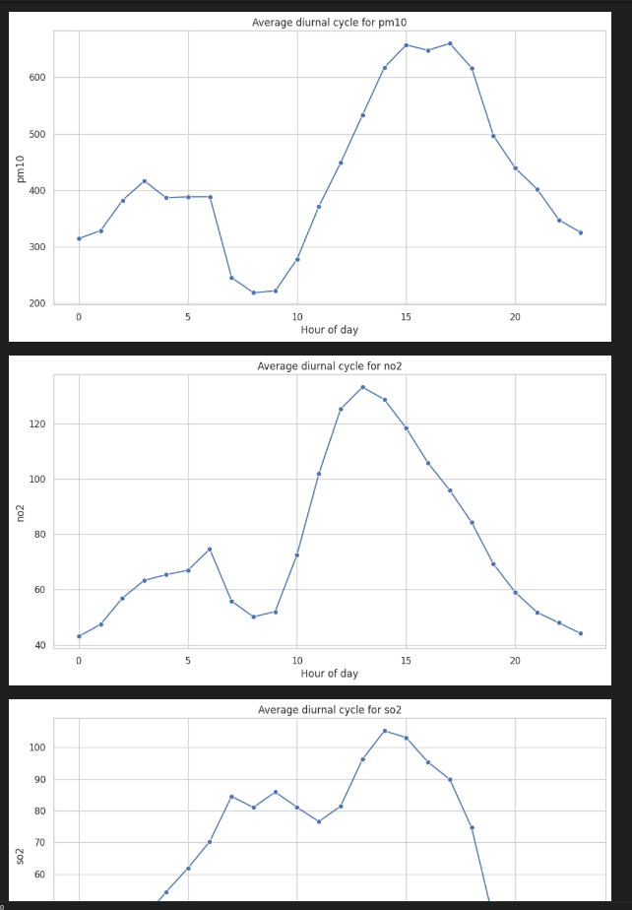
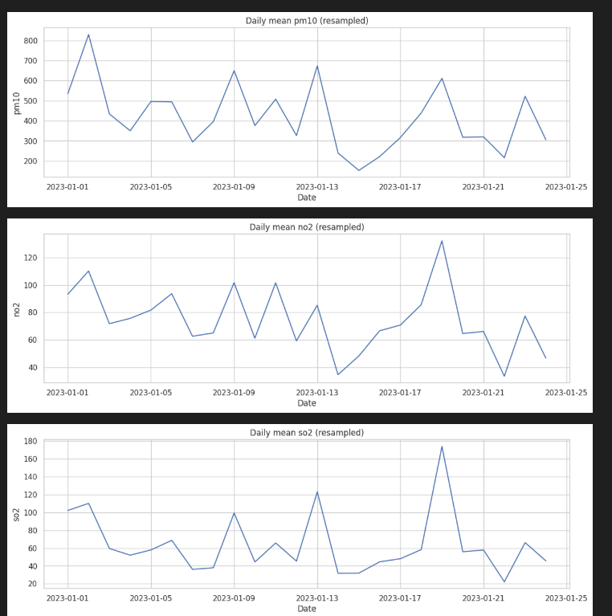
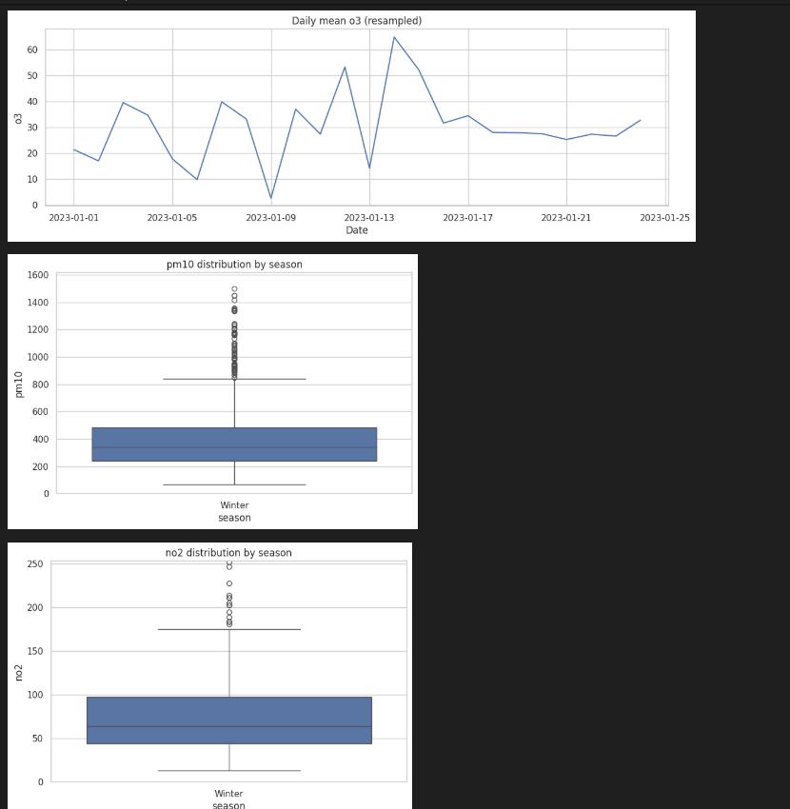
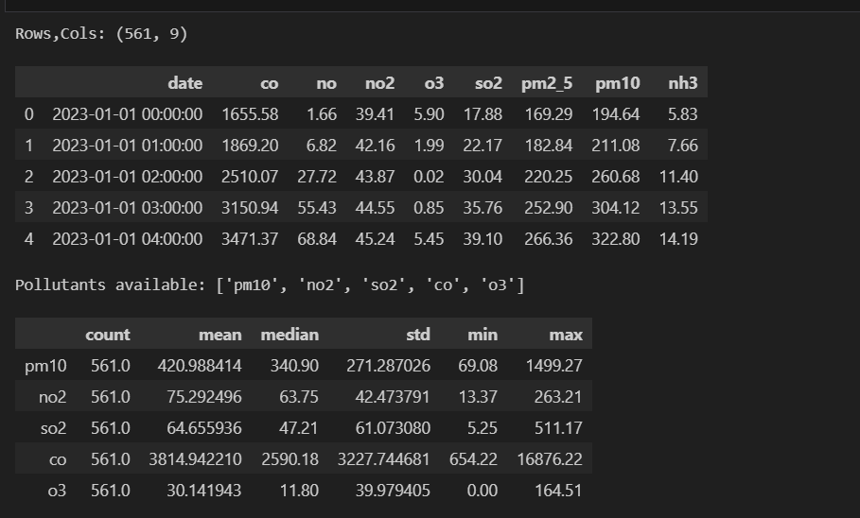
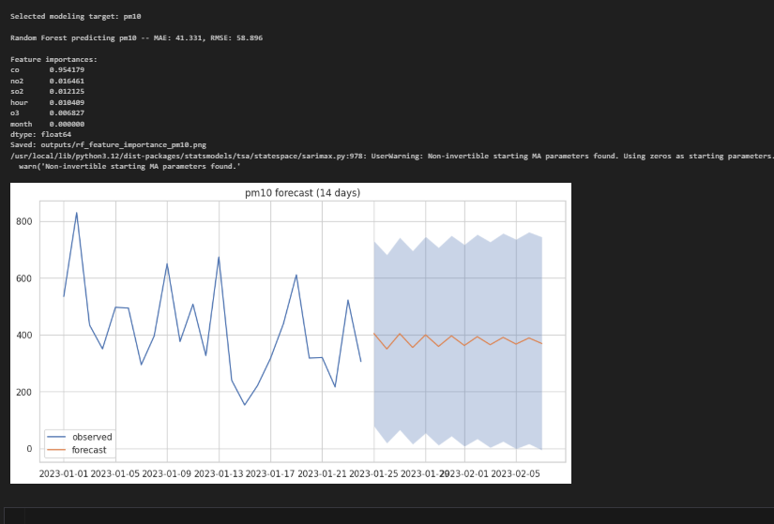
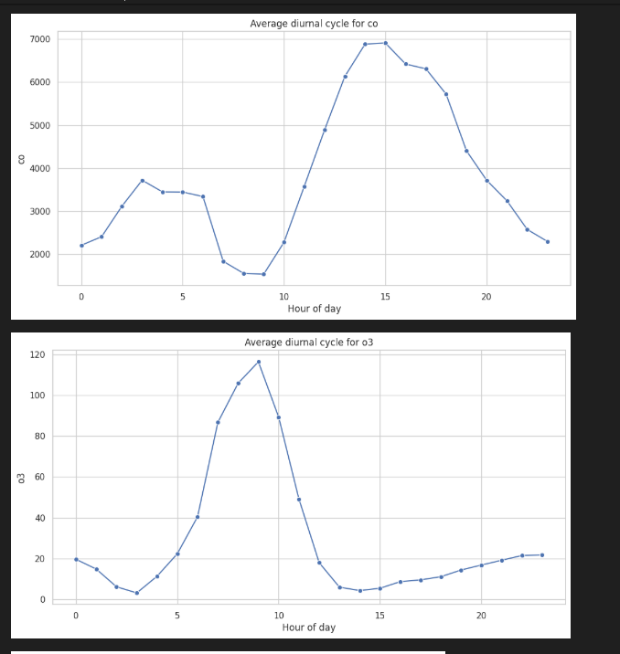
Screenshots 2:

Slide 11
Advanced Level:
Cricket Fielding Analysis: As part of advanced learning, I worked on a cricket fielding performance analysis project. Collected and organized data on player fielding efforts from a T20 match.
Recorded details such as clean picks, catches, drop catches, run outs, direct hits, and runs saved.
Computed performance scores using a weighted formula to quantify fielding impact.
Developed a performance matrix to compare players and highlight their contributions.
Identified areas of improvement in defensive play and recommended strategic insights.

Slide 12
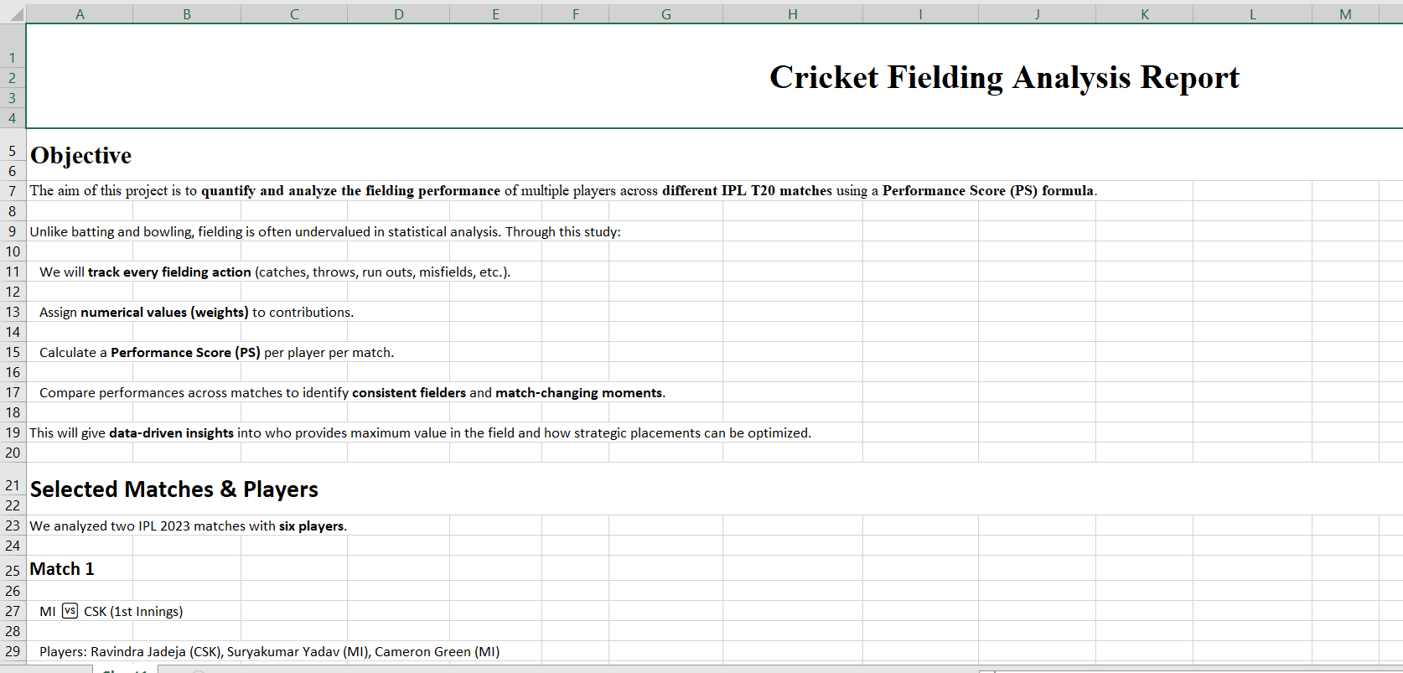
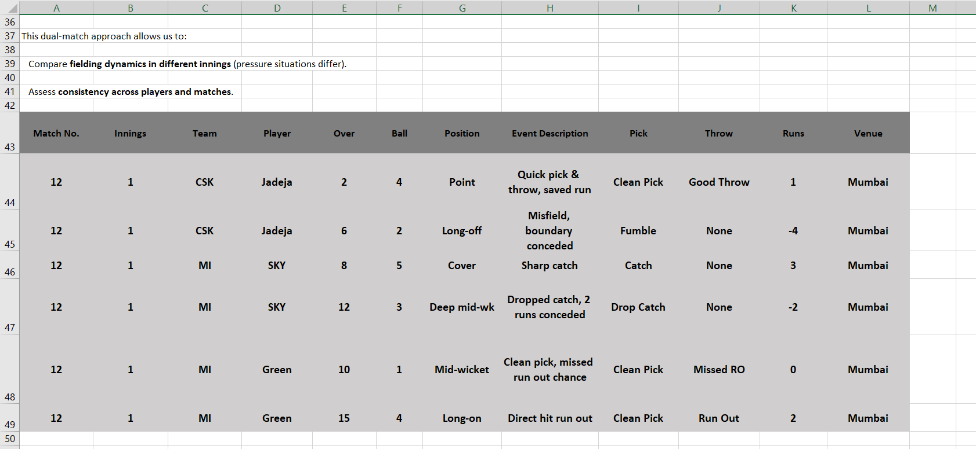
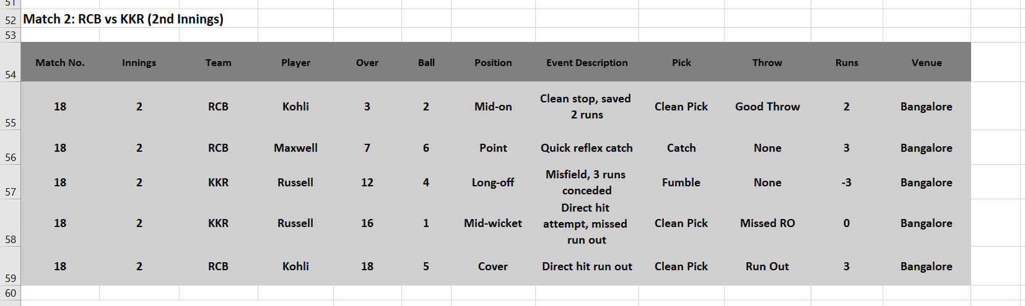
Screenshots 1:

Slide 13
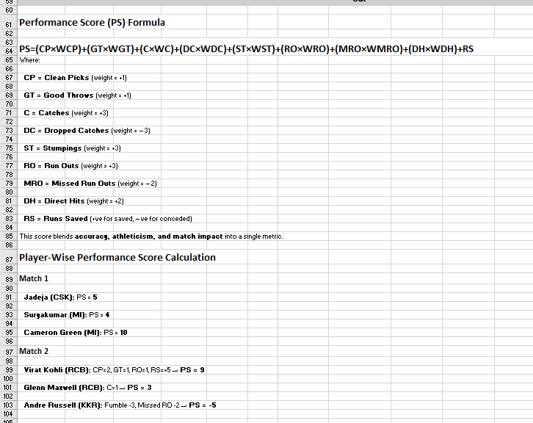
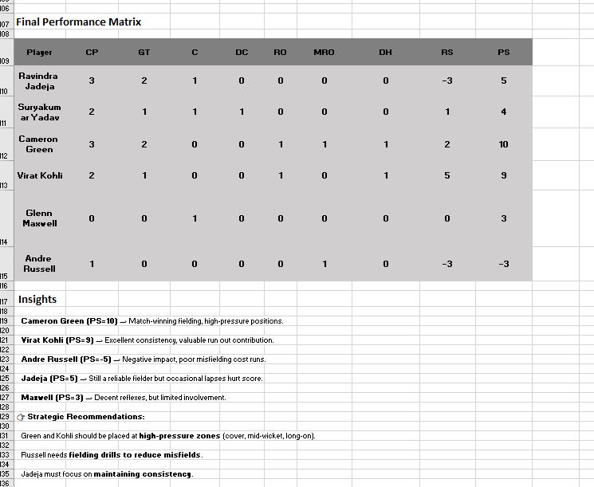
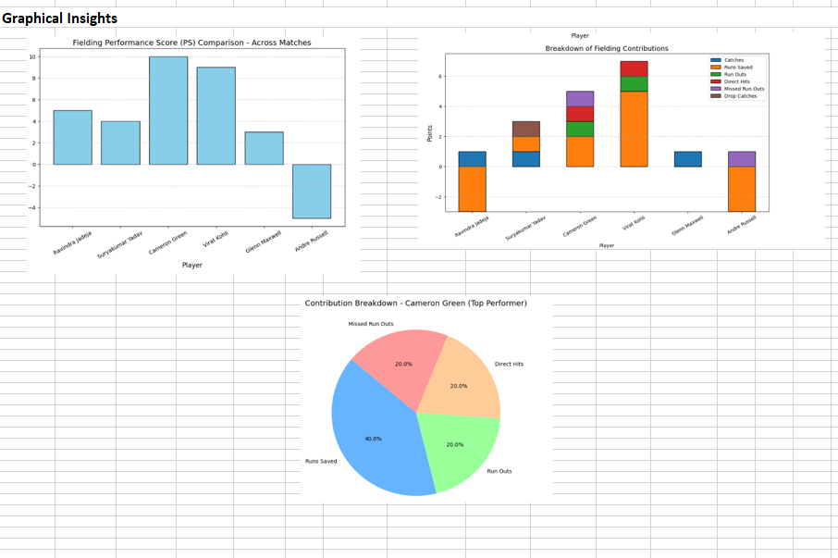
Screenshots 2:

Slide 14
Thank You

